Slide 1

Overview of SQL Serverless in Synapse

Slide 2
Agenda
Recap on what Polybase is.
Dedicated vs Serverless
Directory Structures
Reading Files
Costing
Resources

Slide 3
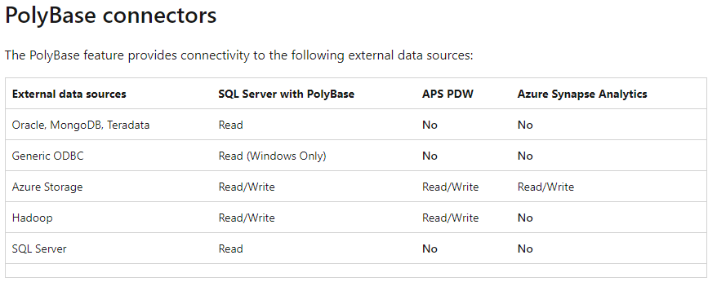
Polybase
PolyBase is a data virtualization feature for SQL Server.
PolyBase enables your SQL Server instance to query data with T-SQL directly from SQL Server, Oracle, Teradata, MongoDB, Hadoop clusters, Cosmos DB without separately installing client connection software.

Slide 4
Polybase uses
Query data stored in Hadoop from a SQL Server instance or PDW.
Query data stored in Azure blob storage.
Import data from Hadoop, Azure blob storage, or Azure Data Lake Store.
Export data to Hadoop, Azure blob storage, or Azure Data Lake Store.

Slide 5
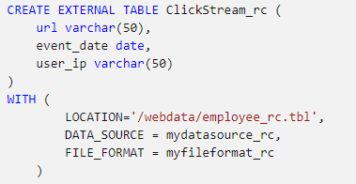
Creating External Tables and inserting data

Slide 6
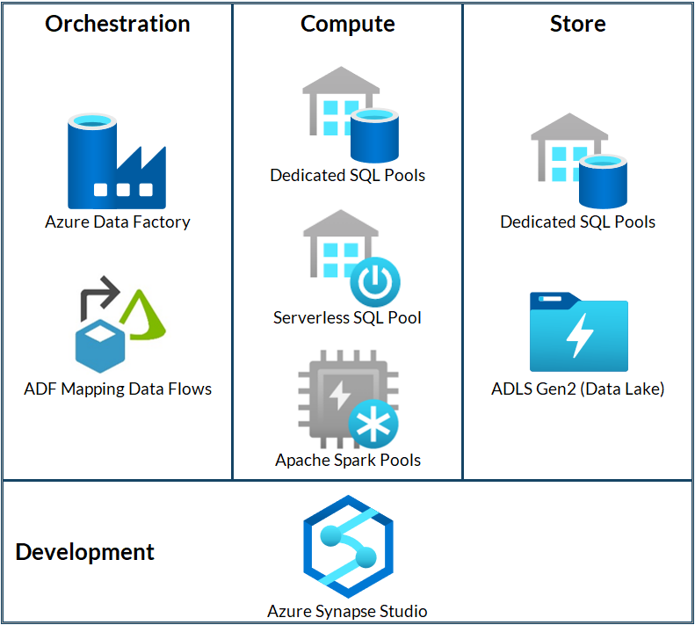
Choosing your data warehouse in Azure

Slide 7
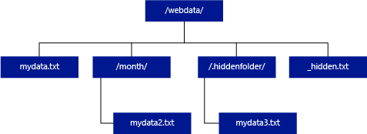
Directory Structure

Slide 8
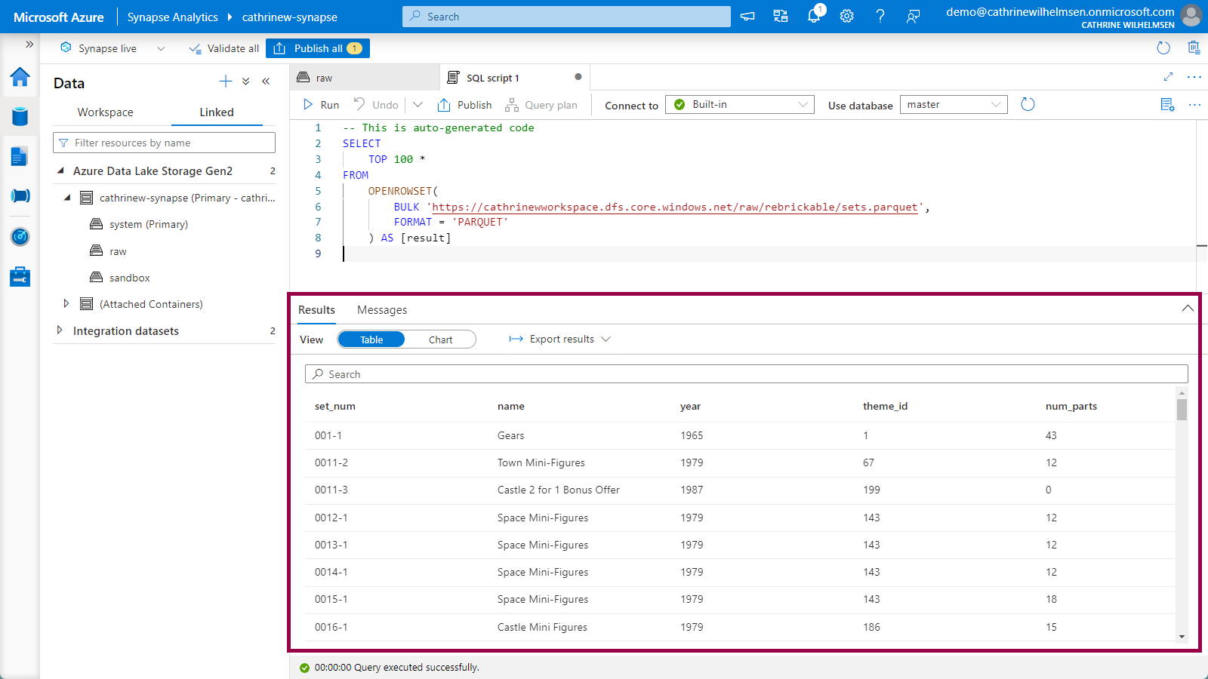
Questions

Slide 9
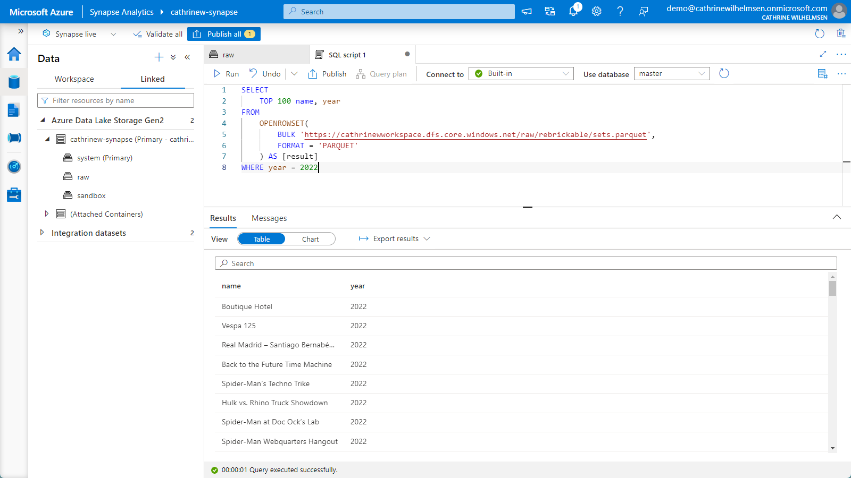
Questions

Slide 10
Resources
https://www.techtalkcorner.com/azure-synapse-analytics-serverless-introduction/
https://www.cathrinewilhelmsen.net/ingest-explore-lego-datasets-using-azure-synapse-analytics/
https://www.youtube.com/c/AdvancingAnalytics?app=desktop

Slide 11
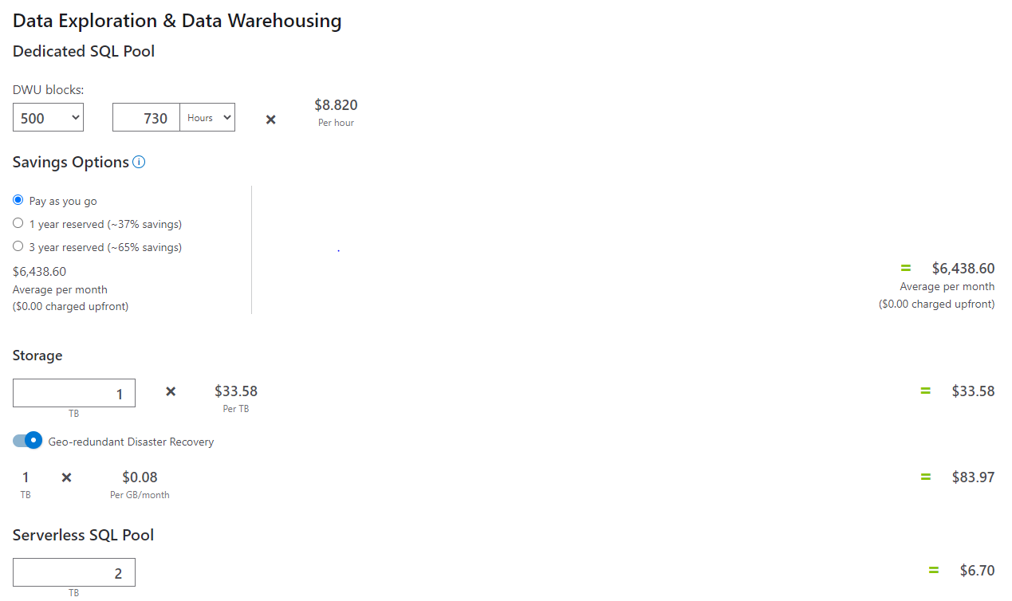
Costing

Slide 12
Questions

